Slide 1
بسم الله الرحمن الرحيم وصلى الله على سيدنا محمد وعلى آله وصحبه وسلم

Slide 2

Charity Organization

Slide 3
Team
Ahmad Gamal Ibrahim Fahim Mazen .
Abdallah Magdi Bedier Matar .
Abdelrahman Ahmad Mohamad Elwan .
Sherief Magdy Mahmoud Mohamad Elbarbary .

Slide 4


Agenda
Description Idea
Functional Requirements.
NonFunctional Requirements.
Use case Diagram.
Sequences.
Activity Diagram
BMC
Architecture
Class Diagram

Slide 5

Description Idea
The idea of ​​the project allows donors to provide what they need to the association, and the needer is able to browse the website or application, provide evidence of his need for this item, choose the classification from the classification list, then choose the item he wants, then the association verifies its credibility through a representative who goes to the needy’s home to confirm..

Slide 6


Functional Requirements.

Slide 7
User | Action
Donor | Register Now Login Select keep me logged Edit password View profile Edit photo Add item Edit item Log out

Slide 8
User | Action
Needer | Register Now Login Select keep me logged Edit password Add comment Categories Show item Select item Verified form Order item Log out

Slide 9
User | Action
Admin | Login Add admin Delete admin Add Category Edit Category Delete Category Delete item Request Accept Request Reject Delete User View user Update

Slide 10

Non-functional Requirements.

Slide 11
Performance :
The website must deliver a responsive and seamless user experience. Page load times should be optimized, with all pages loading within 2 seconds to ensure that visitors can quickly access the information and services they need. In cases of high concurrent user traffic, the website should maintain a high level of performance without degradation.
Security :
Security is paramount. The website must implement robust security measures to protect user data and financial transactions. All data, including personal information and donation details, should be encrypted at rest and in transit. Strict access controls and authentication mechanisms must be in place to prevent unauthorized access.

Slide 12
Usability:
Ensuring the website is user-friendly is essential. It must adhere to accessibility standards to accommodate individuals with disabilities. The interface should be intuitive and well-designed, enabling both beneficiaries and donors to easily navigate and access relevant information or services.
Scalability :
As the website’s popularity and user base grow, it should seamlessly scale to accommodate increasing traffic and user demands. The system must compromising performance. It should automatically allocate additional resources to maintain an optimal user experience.

Slide 13
Reliability:
Reliability is critical for building trust with users and donors. The website should aim for 99.9% uptime, ensuring that it is always available and accessible. Robust monitoring and fault-tolerance mechanisms should be in place to detect and respond to issues quickly, minimizing downtime.
Maintainability :
To ensure the website’s longevity and ability to adapt to changing needs, it should be well-documented and follow coding standards. The codebase should be modular and organized to simplify updates and maintenance. Additionally, a content management system should be in place to enable non-technical users to update and manage the website’s content easily.

Slide 14
Use case diagram

Slide 15
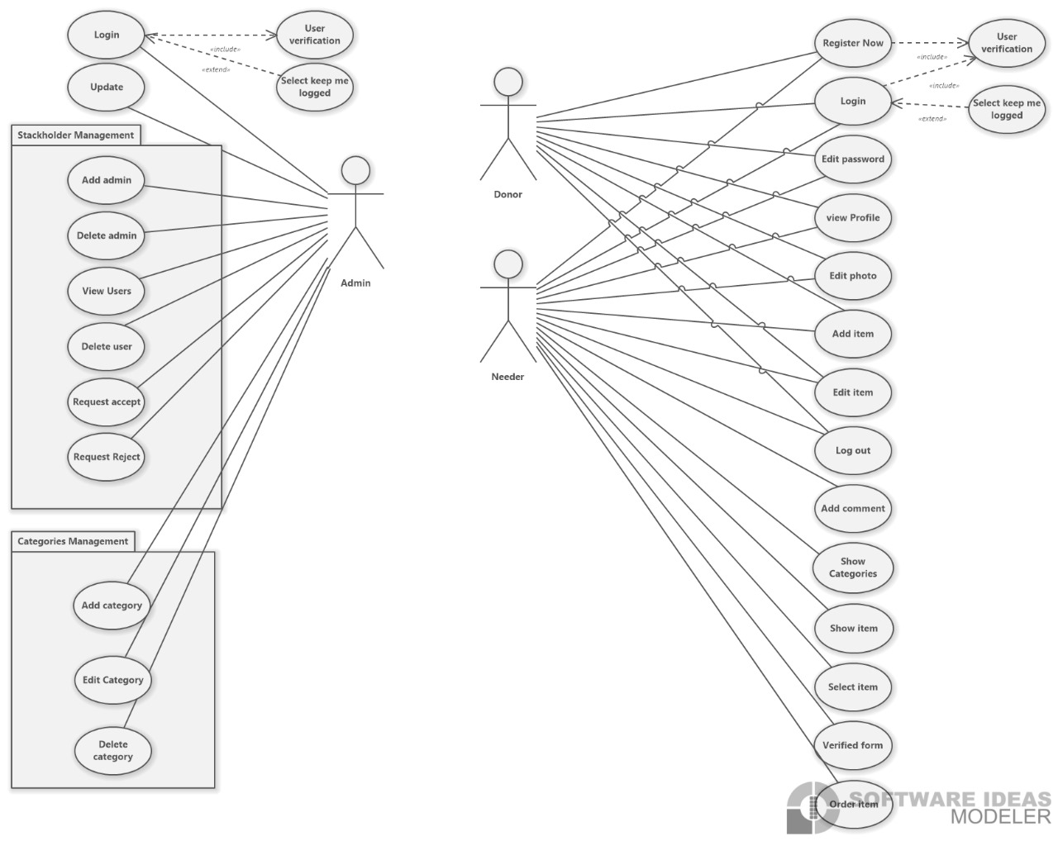

Slide 16

Sequences

Slide 17
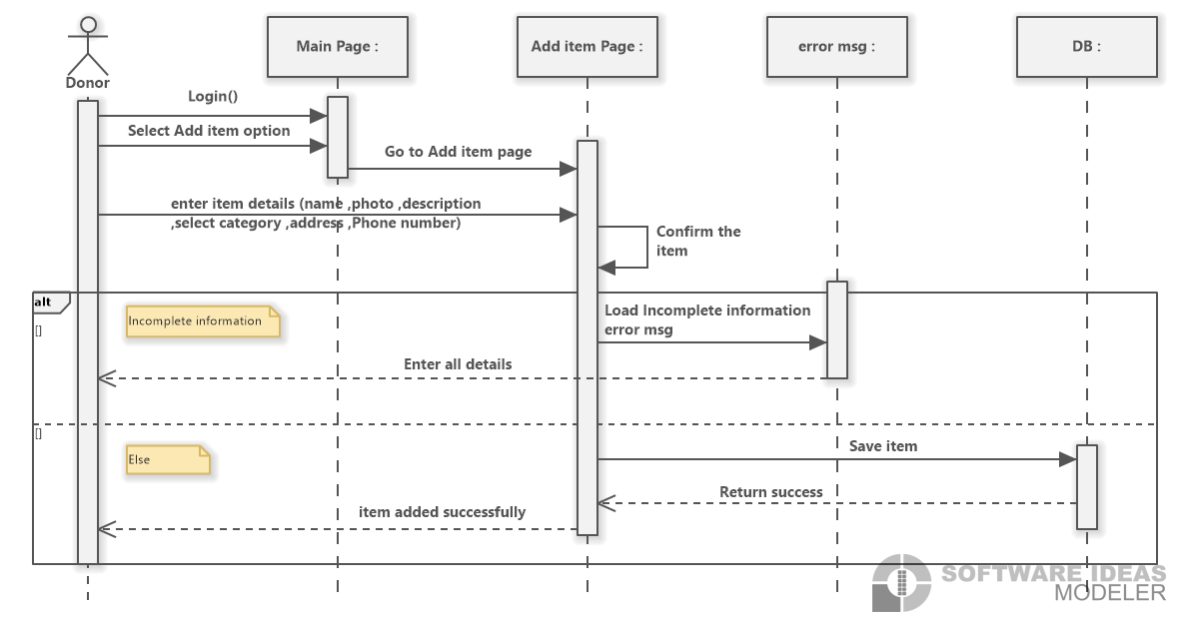

Slide 18
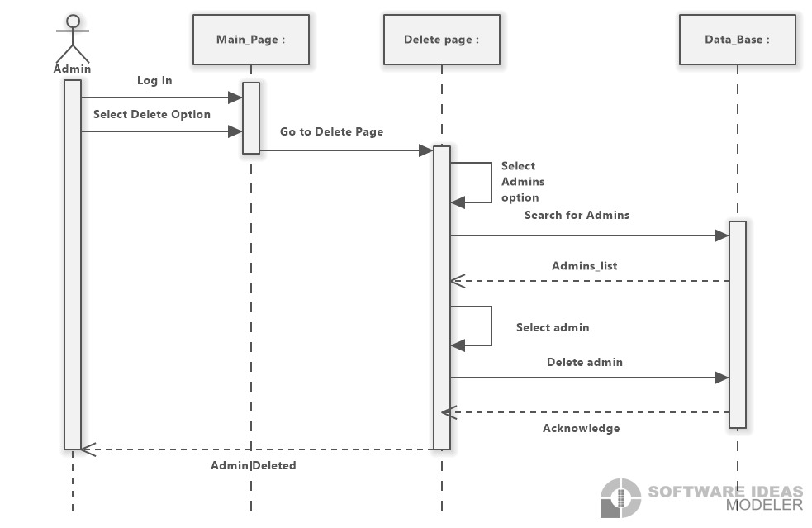

Slide 19
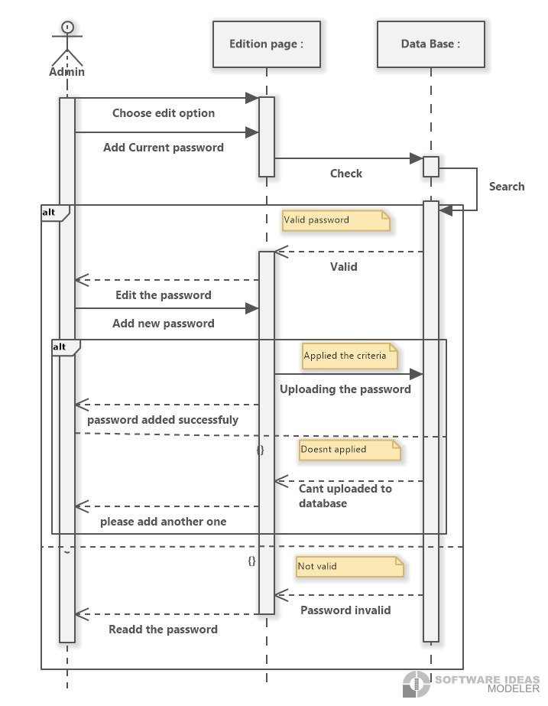

Slide 20
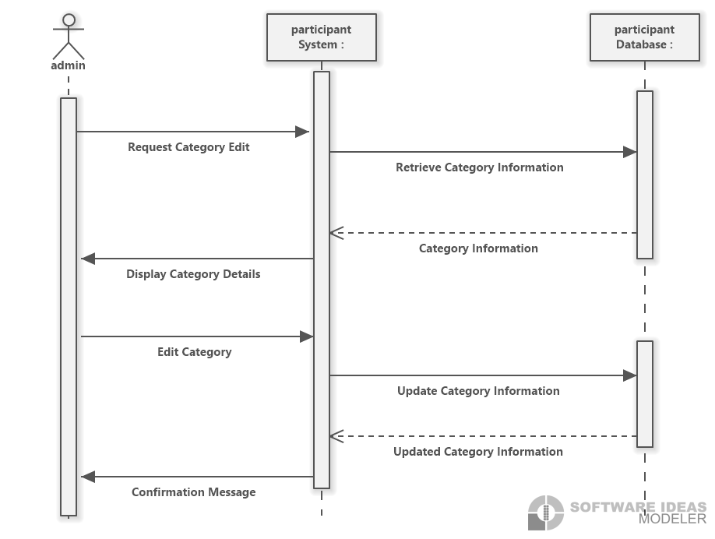

Slide 21
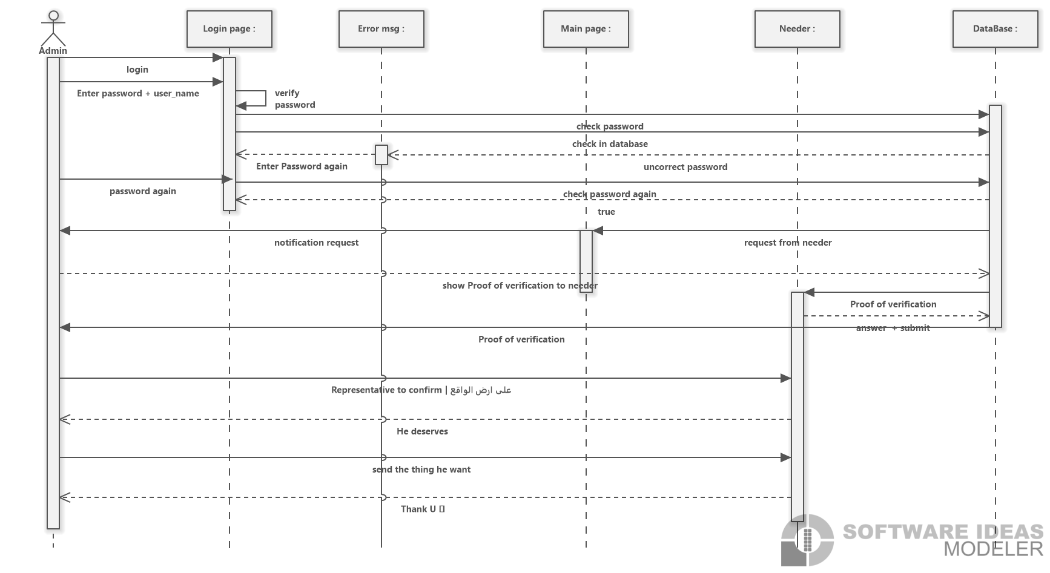

Slide 22
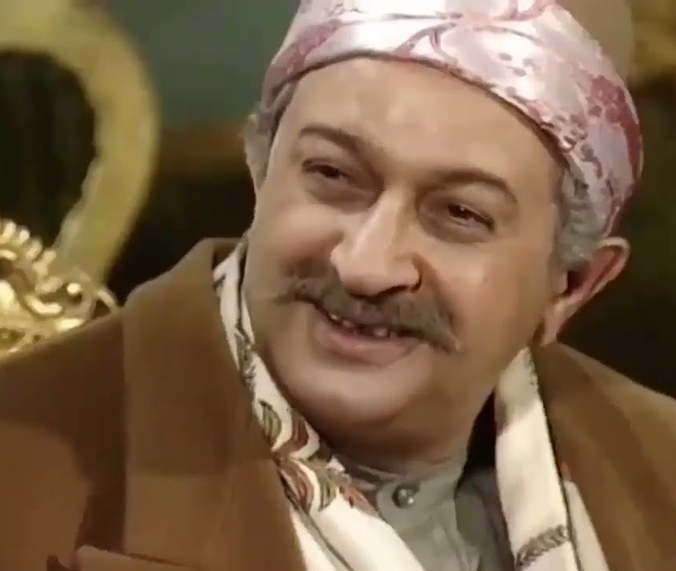
Activity Diagram

Slide 23
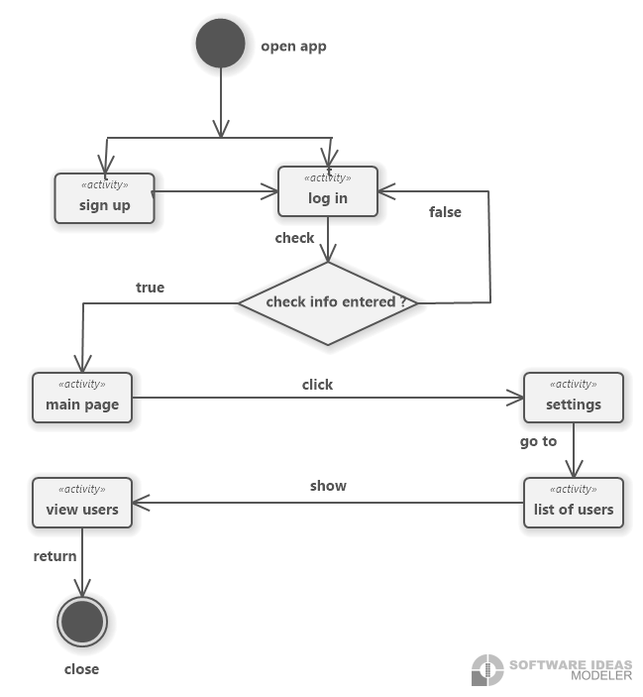

Slide 24
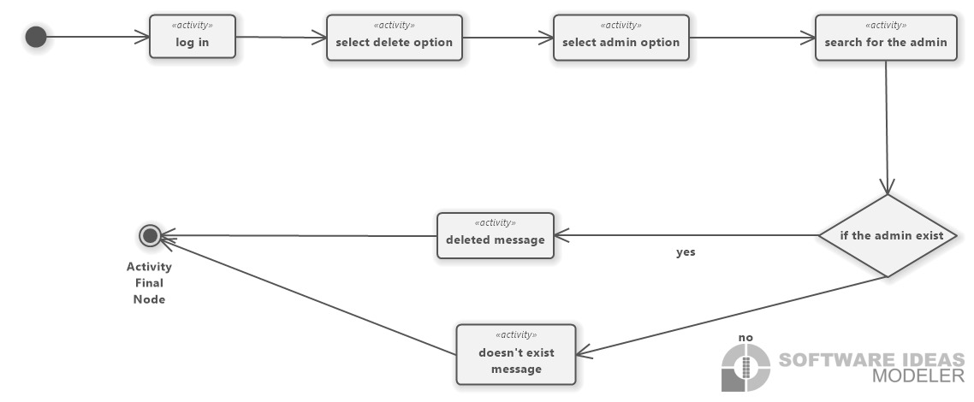

Slide 25
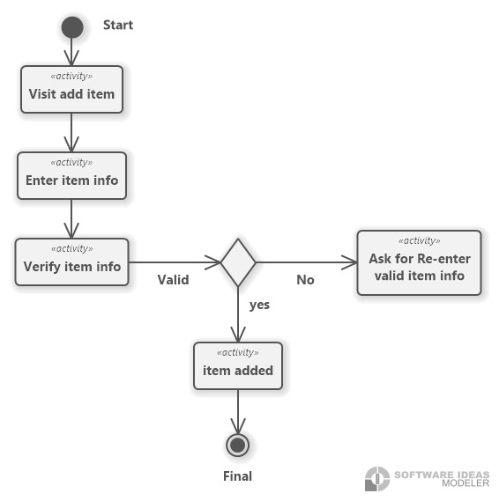

Slide 26
State Diagram

Slide 27
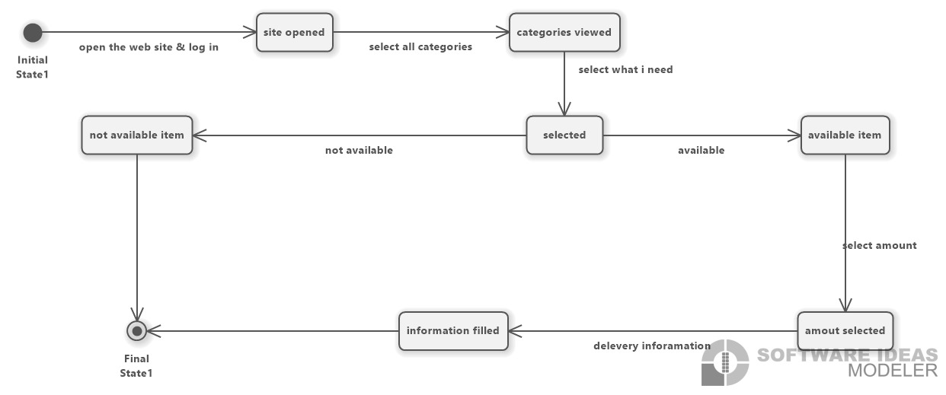

Slide 28
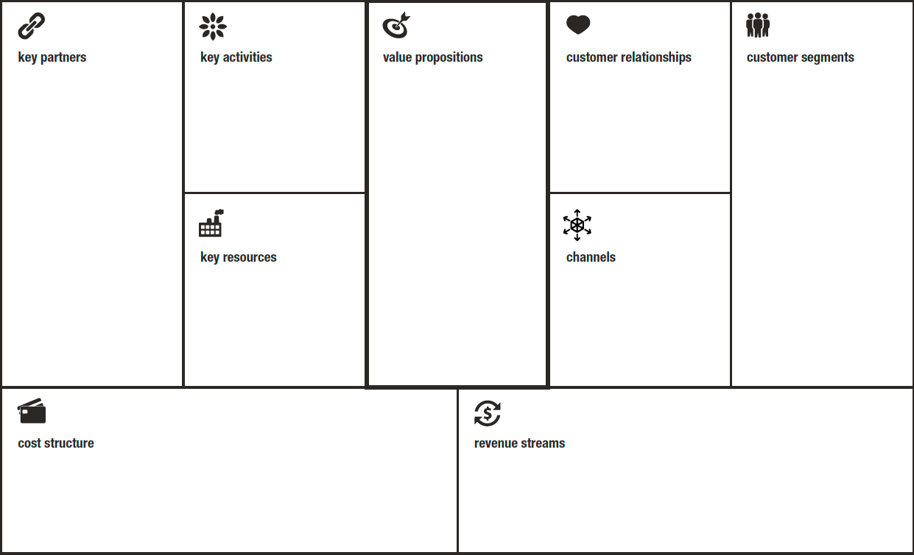
BMC

Slide 29
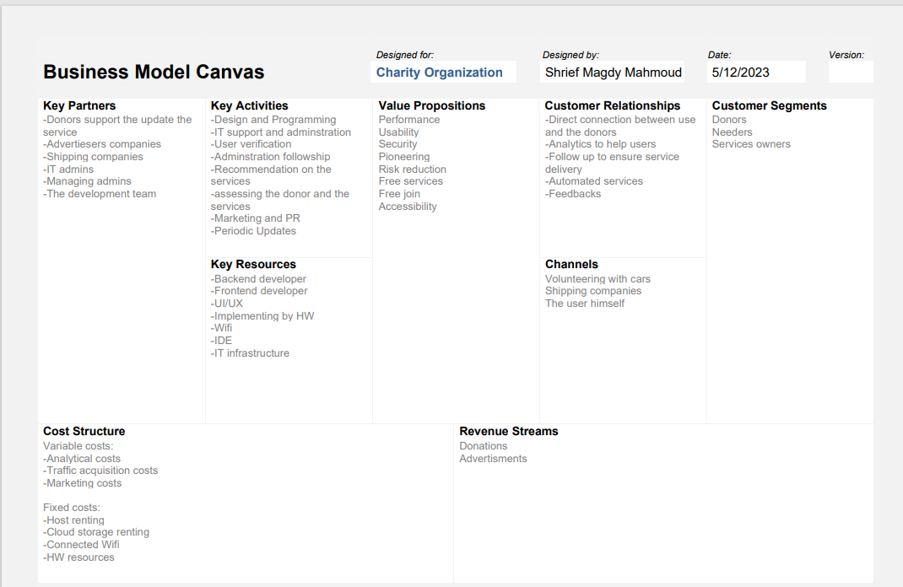

Slide 30


Architecture

Slide 31
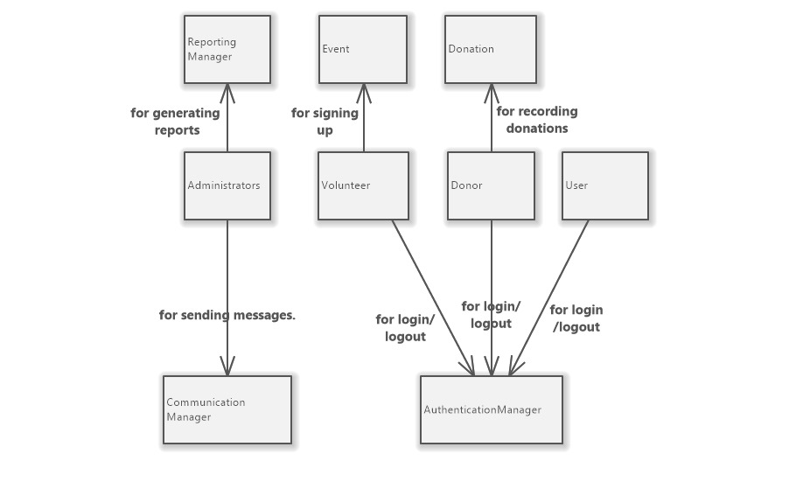

Slide 32
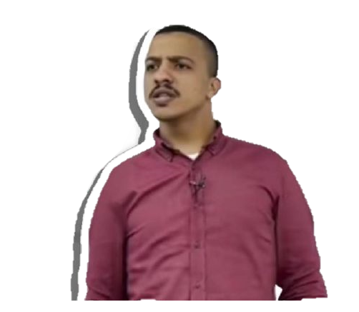
Class Diagram

Slide 33
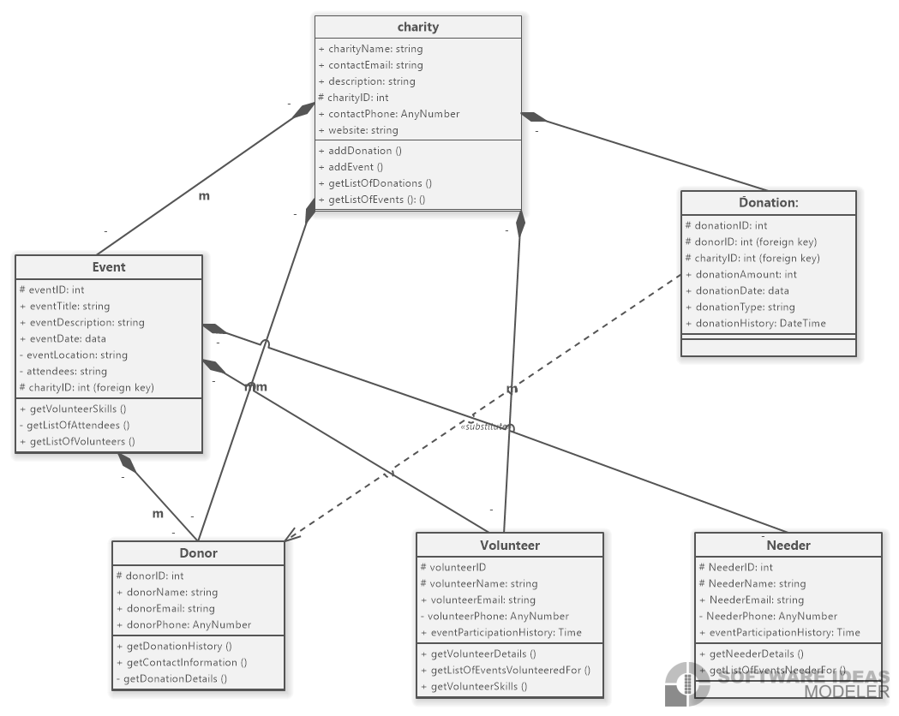

Slide 34


